Slide 1
Deck Usage
Please delete slide before using
This deck will allow you to customize your Bluemix delivery based on your audience.
It is essential that you provide feedback to ensure that this deck is updated with content that is right for your clients
The deck helps you to articulate the story of Hybrid cloud and how IBM differentiates ourselves in the cloud space.
Deck Agenda:
Disrupters can successfully transform and disrupt business
Enterprise disrupt but with different challenges
What is Bluemix and it’s offerings (with demo)
Deployment options and how these work
How do I get started and pricing of Bluemix
Notes:
This is for both sales and text sales with all content to be tailored
Pick and choose the story based on your audience

Slide 2


Digital Innovation Platform
IBM Bluemix

Slide 3
















The rate of innovation is expediential
“Two guys in a Starbucks can have access to the same computing power as a Fortune 500 company.”
Jim Deters - Founder, Galvanize
Design Thinking
Runtimes
APIs
Micro
services
IoT
Extreme
Agile
Tooling
Containers
Notes:
The digital disruption is underway across all industries, and at the core of this disruption is a transformation and acceleration of innovation, development and delivery methods. Enterprise executives recognize the significance of this transformation and are seeking ways to bring the culture of startup innovation into their enterprise. They need to lead the digital disruption or risk being disrupted -- digitally disintermediated from their customers, employees, or suppliers. Born on the cloud startups are leading many disruptions and using new methods to achieve these disruptive innovations.
These digital disruptors are delivering new business models and customer value at high speed and high quality, continuously iterating and experimenting in-field to achieve their desired business outcomes. Pivoting and rapidly iterating to achieve customer adoption and revenue growth.
These new methods, typically discussed as DevOps, encompasses a transformation of culture, processes and tools. In a manor that accelerates innovation, rapid instantiation of new services, and data driven iterations

Slide 4
Innovation makes disruption possible.
Bluemix works
for disruptors

Slide 5

New Business Value
Enterprise want to disrupt, but...
Existing
Applications

Slide 6


Companies of all sizes have ability to disrupt,
or face the prospect of being disrupted.
Successful business will be the ones that embrace change and innovation and transform at speed.
Deliver the right app
to the right user
at the right time
for the right experience
Notes:
Slide Intention
Start the conversation. *Talk to Uber and how it disrupted the way users view/expect transportation*
Technology shifts are driving unprecedented business transformation
The new class of innovative and disruptive companies build apps and services, they don’t run data centers
The most successful enterprises will be the ones that embrace change and innovation and transform at speed

Slide 7



Enterprises need instrumented, automated coordination for two-speed IT
Bluemix enables
Possess a unique capability by leveraging existing systems
Enterprises need to find a balance between IT & Innovation.
Hybrid is a great opportunity to develop new business via digital channels.
Disruption can occur when enterprises are slow to adapt
Rapid iterations
Production
Develop
Build
Test
Deploy
API Catalog
Systems of Interaction
Digital Applications
Systems of Record
Enterprise Applications
Slower iterations
Develop
Build
Test
Deploy
Production
Enterprise have different requirements
Application monitoring and loggin
Corporate Policies
Regulations
White Labelling
LDAP Integration
Security and Privacy

Slide 8
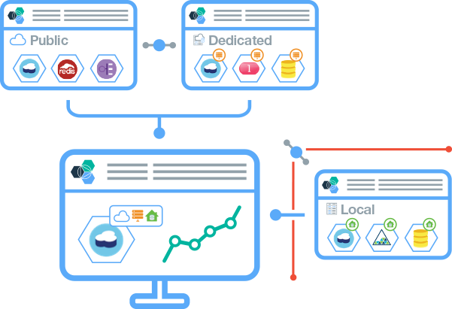

Bluemix delivers the cloud value proposition
Today, cloud is being consumed at an expotential rate. Cloud is a game changer in the way we consume and manage IT today.
Enterprises are aggressively implementing their clouds strategy, however, manageing this environment is costly and resource heavey
1
Provides an Innovation Platform that is open and non-proprietary, delivers everywhere and you can start anywhere – public, private, on-prem, off-prem
2
IBM Managed Cloud that allows developers to innovate quickly and addresses your needs for security and compliance.
3
Provide turn key delivery that allows you to get started immediately with Bluemix and grow as your needs mature.
Notes:
IBM managed platform
Bluemix is a fully managed platform offered seamlessly across public, dedicated and local deployments. Leverage IBM’s experience and expertise to provide a platform that is always current and always available.
24/7 Ops Team
Expertise gained by running the worlds largest Cloud Foundry environment supporting over 1B API calls per day
A true partnership with IBM
In addition to ensuring that your environment is always current, the IBM Global Operations team will monitor your Bluemix installation ensuring you have the responsiveness, capacity and availability required to run enterprise workloads
Priced based on usage/provisioning
Take advantage of economies of scale in the public model and enjoy the flexibility to expand and contract in private models.
Where you need it
Bluemix provides a consistent experience across the public cloud and two private models (Dedicated and Local). Start quickly and adopt a model as your workload matures. Run application workloads where you need to with the flexibility to adapt to changing market conditions and regulations

Slide 9
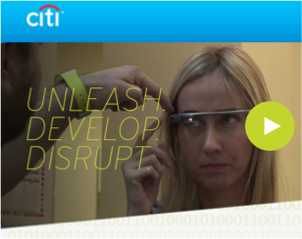
Citi Mobile Challenge Selects Bluemix
Goals:
Provide developers with a unique, global developer ecosystem.
Accelerate the mobile development of innovative financial service solutions for their customers in order to retain customer retention.
Why Bluemix?
“IBM Development tools challenged Citi into helping them turn ideas into innovative realities.
The IBM Cloud Platform and industry API’s enable developers to quickly create mobile solutions by offering new services on their mobile device like never before.”
“IBM's recognition that the Citi Mobile Challenge is fostering the development of the next generation of FinTech solutions serves as great validation of our efforts to accelerate and lead digital innovation,"
Heather Cox, Citi Chief Client Experience, Digital and Marketing Officer for Global Consumer Banking
Notes:
Any size company can drive distuprion – small or large.....even one of the largest in the world
When Citi looked to change/disrupt their business model, they went to Bluemix
“People want banking, not banks” Systems of engagement, they come to us… scale
Message: Citi is driving innovation in the financial markets. Pick 1 powerful message/slide 5-7, put others in back-up (Cross Industry)
Go to this wiki for your Geo to introduce business models that changed the game.

Slide 10

What is Bluemix?
Inspiring Innovation
Notes:
Bluemix has been a huge game changer in the way we consume and use applications – Look further at what Bluemix really is and how it can be used

Slide 11
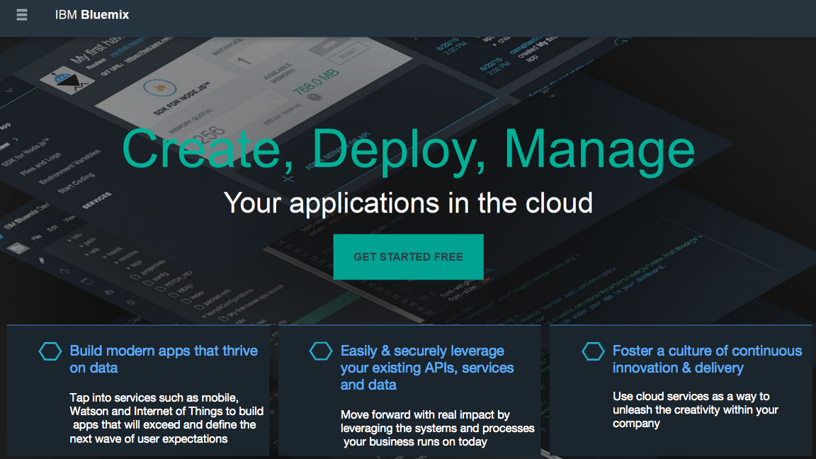

Slide 12
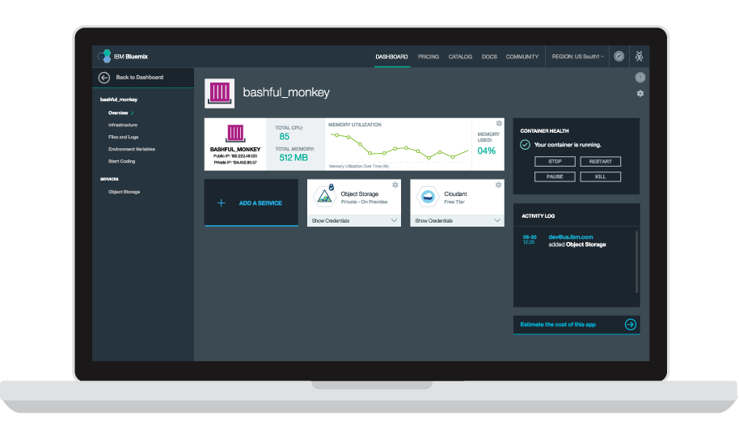





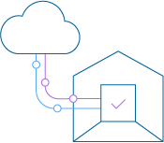
The Bluemix Platform
Core Platform
App Centric Compute
Global // Hybrid // Open
Global // Hybrid // Open
PaaS // Container // VM’s
API’s
Data Driven App’s
IBM // 3rd Party // Yours
Watson // IoT // Big Data
Easily & Securely leverage your existing API’s & Data
Build modern apps that thrive on data
Powered by Open
Built for enterprise
IaaS // PaaS // SaaS
Development // Integration // DevOps
Optimize and transform existing apps
Foster a culture of continuous innovation & delivery
Notes:
Enterprises need a cost efficient, robust and open platform to unleashes developer productivity and foster digital innovation
Bluemix is IBM's digital innovation platform that is cloud based, open, ready for hybrid, leverages existing assets, productive, modern, up to date etc.

Slide 13

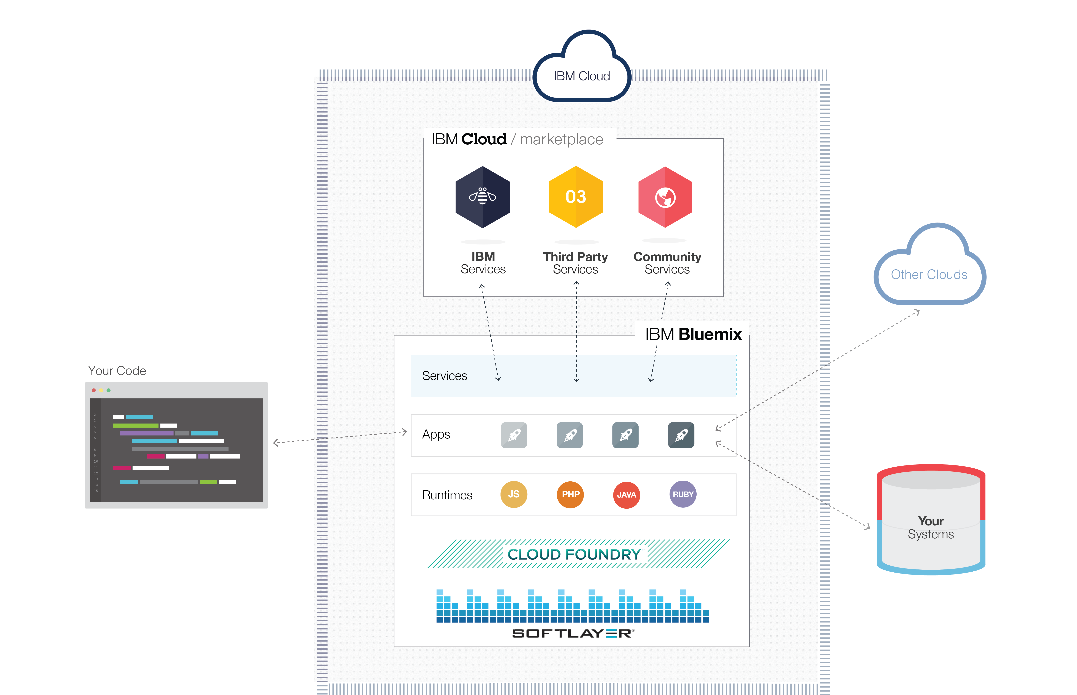









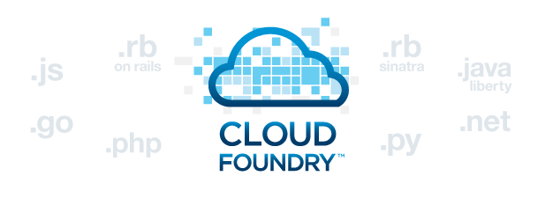




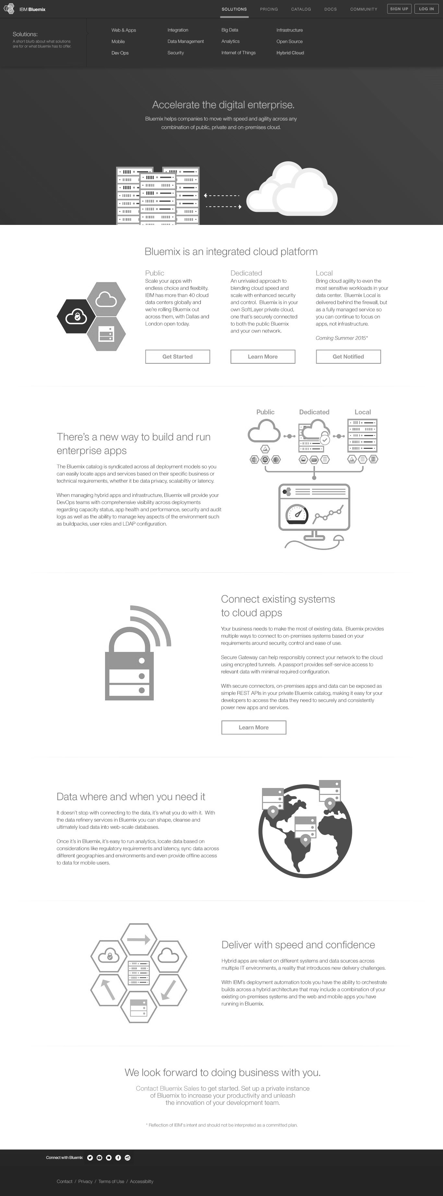
How does Bluemix work?
DevOps
Tooling
Integration & API Mgmt
Bluemix is also built on 3 key open compute technologies: Cloud Foundry, Docker, and OpenStack.
Your Own Hosted Apps / Services
Catalog of Services that Extend Apps’ Functionality
+
It extends each of these with a growing number of services, robust DevOps tooling, integration capabilities, and a seamless developer experience.
Web
Data
Mobile
Cognitive
Analytics
IoT
Security
Yours
Flexible Compute Options to Run Apps / Services
Instant Runtimes
Containers
Virtual Machines
+
+
+
Platform Deployment Options to meet Workload Requirements
+
Bluemix
Public
Bluemix
Dedicated
Bluemix
Local*
+
Powered by IBM SoftLayer
In Your Data Center
Notes:
Start at the bottom of the stack and work to the top (From Deployment models/flavors through the ability to host your own services/api’s) before going into the extendibility of using your own tool and an ‘out of the box’ API management system.
Slide transitions are built into the deck to help articulate the story

Slide 14
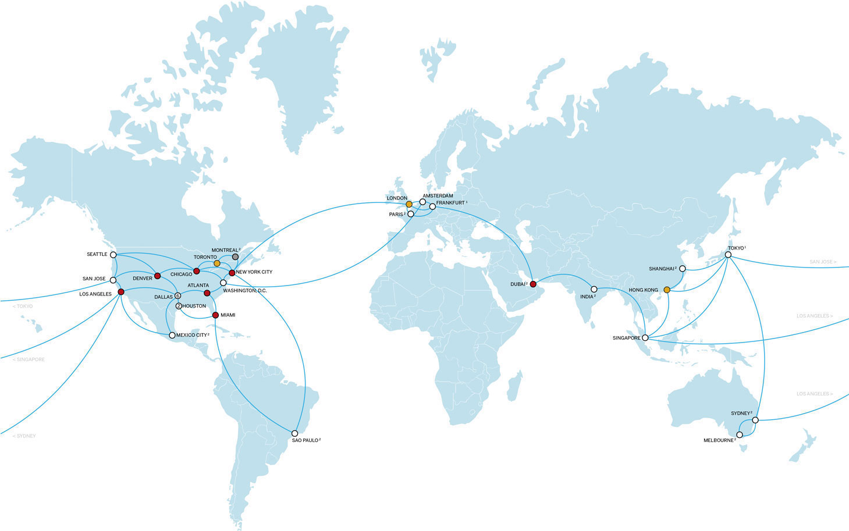
Built on the Highest Performing Cloud Infrastructure
Spanning across the globe
A different kind of data center
Every location designed, built, and operated to the same standardized, “pod” based spec
24/7 on-site security and rigorous controls
Public, private, and management networks all separate
More than 2,000Gbps between data centers and network points of presence (PoPs)
Unmetered inbound public bandwidth and fully unmetered bandwidth between data centers
Entirely automated
SoftLayer API controls everything
Bare metal and virtualized servers in the same platform
Carrier grade private network with over 2,000 Gbps of connectivity
Over 29 global locations with geographic disperse network PoPs
Notes:
Completely automated – Bluemix is built on top of IBM’s infrastructure as a service offering - SoftLayer. It embraces Cloud Foundry as an open source platform as a service and extends it with IBM, third party, and community built services.
SoftLayer has uniquely designed and deployed a global, interconnected platform that’s designed to meet the key operational and economic requirements of cloud infrastructure across a broad portfolio: dedicated and shared devices, physical and virtual servers, hourly compute instances and four-way, octo-core bare metal, along with a wealth of storage, networking and security components.
You can take these building blocks and deploy public cloud instances, build private clouds on your choice of virtualization stack, leverage the raw power of bare metal on demand, or combine these solutions into distributed, hybrid architectures. Build what you want, or leverage our turn-key big data and private cloud solutions to design and deploy complex, scalable infrastructure online in near-real time. It’s all delivered as a unified service, managed from a single pane of glass via our web portal or mobile apps, and accessible via a powerful, full-featured API.
Our bare metal option mirrors on-premises resources across a continuum of single processor servers, quad proc, hex-core, and even graphics processing unit (GPU)-powered. It deploys in near-real-time via the self-service portal or API.
Within our dedicated virtualized environment, you have a variety of hypervisor choices, including:
VMWare
Citrix (Xen)
Parallels
Hyper-V
OpenStack
Finally - when your app is built and ready to go, it can be accessed by anything with a web browser and a connection to the internet, a smartphone app (via the Bluemix SDK) to utilize backend services, or another type of app or system (via an API you create).

Slide 15
Compute flexibility
Devs get to choose the level of infrastructure abstraction and fine-tuned control that suits their apps and services.
Instant Runtimes
Containers
Virtual Machines
The highest level of infrastructure abstraction. Focus on the app.
Powerful, but less resource intensive than VMs. Key to supporting hybrid portability.
Control all the way down to the operating system.
What’s different about Bluemix?
Docker as-a-service means no VMs to manage
A repository of enterprise-grade images which are trusted and secure
Enhanced performance and scalability
Integrated monitoring, logging, networking, and storage
Extends Cloud Foundry with DevOps tooling, integration capabilities, and seamless app management
Support for 7 key languages and the option to use a community buildpack.
Deploy and manage VMs consistently across public, dedicated, and private instances with a single dashboard.
Connect to your own OpenStack infrastructure

Slide 16
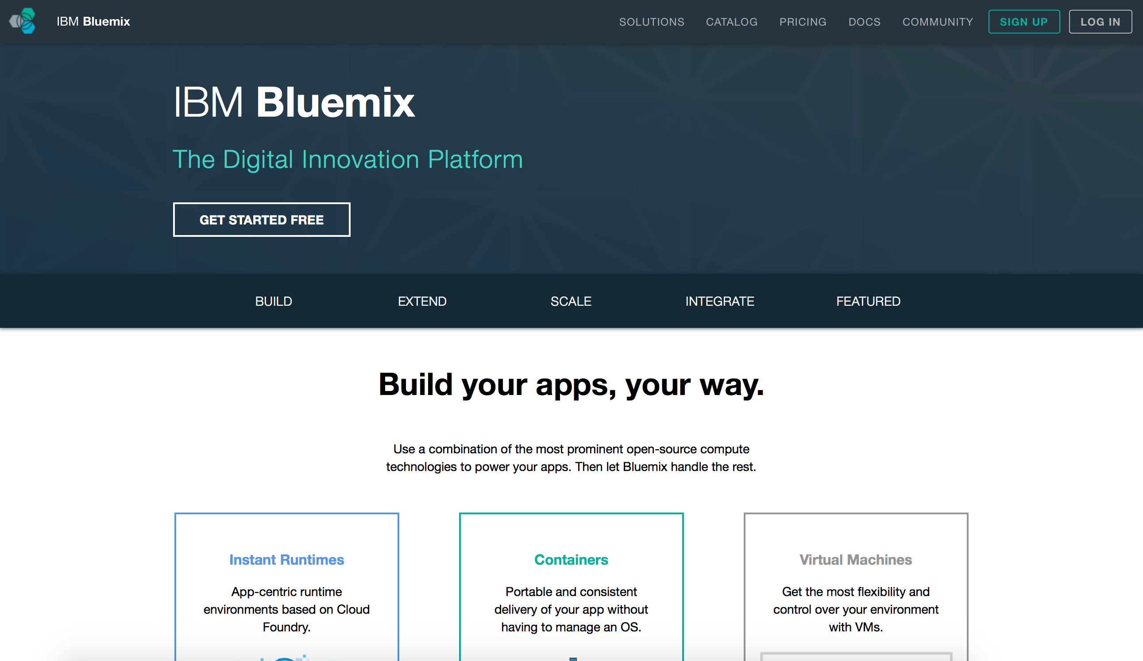
Let’s see it!
*click*
Notes:
Link to a page with 3 demo’s
1Minute Demo

Slide 17
Innovation makes disruption possible.
Bluemix deployment
for everyone,…..everywhere

Slide 18
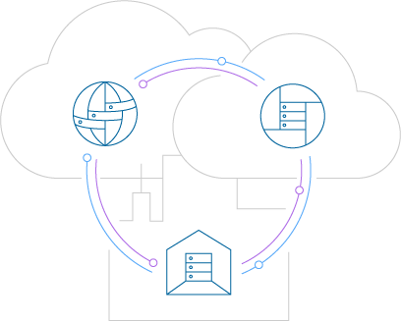



1.5 Years of Bluemix
Today
Bluemix Local
140+ services
Feb 2015
Virtual Machines
Containers
100+ services
Evolution based on customer need:
More compute choices
Deployment flexibility
Increased support for hybrid scenarios
Deeper foundation services
Further depth of control for IT admins
Improved performance and scale of open source
Nov 2014
Bluemix Dedicated
London Region
70 services
June 2014
35 services
New pricing structure
Feb 2014
Public PaaS
5 Services

Slide 19

A powerful set of hybrid deployment models
We deliver everywhere, so you can start anywhere
Public Tap into over 100 IBM and 3rd party services across mobile, IoT, Watson and more to power your modern apps and services. | Dedicated Experience an unmatched combination of security and time to value in a cloud that feels like a natural extension of your existing network. | Local Take advantage of the true value of cloud behind your firewall with the help of our first-of-its-kind approach to private cloud delivery.
Across public, dedicated and local cloud, has the same look and feel
Key experiences unify the platform deployments
A True Seemless Experience
Notes:
Enterprises can adopt Bluemix in different interoperable deployment models
Security requirements can be met with Bluemix private cloud, on SL or in your data center

Slide 20





Bluemix – Public Cloud
Bluemix is a multi-tenancy open-standards, cloud-based platform for building, running, and managing applications.
Build your apps, your way
Use the most prominent compute technologies to power your app: Cloud Foundry, Docker, OpenStack.
Deploy and manage hybrid apps seamlessly
Get a seamless dev and management experience across a number of hybrid implementations options.
Scale more than just instances
Development, monitoring, deployment, and logging tools allow the developer to run and manage the entire application.
Layered Security
IBM secures the platform and infrastructure and provides you with the tools to secure your apps.
Flexible Pricing
Try compute options and services for free and, when you’re ready, pay only for what you use. Pay as you go and subscription models offer choice and flexibility.
Extend apps with services
A catalog of IBM, third party, and open source services allow the developer to stitch an application together quickly.
Coming Summer 2015

Slide 21

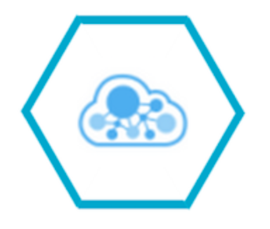

Bluemix – Private Cloud
Bluemix Private Cloud is a single-tenancy open-standards, cloud-based platform for building, running, and managing applications, available as Dedicated or Local
Bluemix Dedicated
Bluemix Local
Dedicatd to you
A single tenancy envoirnment that is dedicated to you – allowing you to satisfy regulatory and legal compliance
Deployment Choice
Bluemix Local runs on either VMWare or OpenStack driven infrastructure.
*OpenStack coming soon
•
Focus on App’s – Not Iron
Focus on building customer applications and services. IBM manages the platform and your dedicated service
•
Portable Apps & Services
Move workloads as performance requirements or regulation change
•
Global Locations
Bringing you closer to your user with dedicated living in any SoftLayer data center around the globe
•
We’re on call – 24/7
Experts are always on hand to solve your problems. Premium support options are available to meet your requirements
21

Slide 22
Bluemix offers choice. What is the difference between the offerings?
 | Public | Dedicated | Local
Tenancy | Multi | Single | Single
Payments | Pay-Go & Subscription | Subscription | Subscription
Infrastructure | IBM Provided | IBM Provided | Customer Provided
Provisioning | Instant | 2 weeks* | Customer Dependent
IaaS | Softlayer | Softlayer | Openstack or VMWare
Softlayer | Dallas & London & Sydney | Any Location | NA
Catalog | Public | Syndicated | Syndicated
*Typically limited by customer network and security configuration
Notes:
Bluemix is built on top of IBM’s infrastructure as a service offering - SoftLayer. It embraces Cloud Foundry as an open source platform as a service and extends it with IBM, third party, and community built services.
Explain Diagram (verbs in blue - please use this terminology)
Start by Pushing your code through Cloud Foundry
Cloud Foundry interprets which language you’ve used and associates your code to the appropriate runtime - now you have a working app (layer above runtimes).
Your app can
Pull prebuilt services (IBM, 3rd party, or community built) in from the marketplace and utilize their functionality
Connect to traditional IT - aka “Your Systems” with a secure connector
Connect to other clouds that you utilize with a secure connector
All of this sits on infrastructure (networking, storage, servers) hosted by IBM Softlayer (IBM’s IaaS cloud offering)
Finally - when your app is built and ready to go, it can be accessed by anything with a web browser and a connection to the internet, a smartphone app (via the Bluemix SDK) to utilize backend services, or another type of app or system (via an API you create).

Slide 23
Who manages what
Area | IBM Responsibility | Customer Responsibility
Platform Management | Manage the Platform layer Platform Installation and Configuration Manage Updates and Security Fixes Help Customer Manage Capacity Install additional Services/Features Backup and Restore | Manage the IaaS layer Manage select Platform capabilities via the Administration Console Manage Catalog (add/remove services and runtimes for their orgs) Monitor Environment
User Management |  | Manage Users via LDAP
Platform Updates | Ensure highest quality experience by fully testing new features, updates and fixes and validate in Bluemix Public Publish updates within 3 weeks | For non-critical updates, customers select a day within a 21 day window for the update to be applied If the customer does not select a date, the update will be applied at the end of the window
Security | Monitor Platform Security Identify and fix vulnerabilities Clear Communication with Customer | Review security and audit logs Manage Firewalls and IaaS security
Capacity Management | Provide usage reports and projections Provision or de-provision capacity at the Platform level based on customer requests | Track usage and project future growth Manage IaaS Capacity
Problem Resolution | Proactive Monitoring, Troubleshooting and Problem resolution of PaaS and IBM provided services | Proactive Monitoring, Troubleshooting and Problem resolution of IaaS, Networking, and customer services and applications

Slide 24
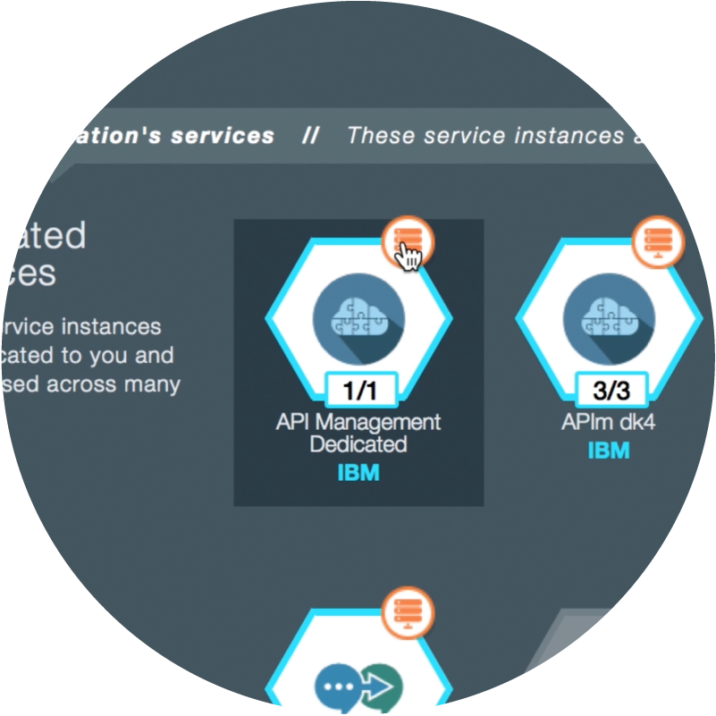
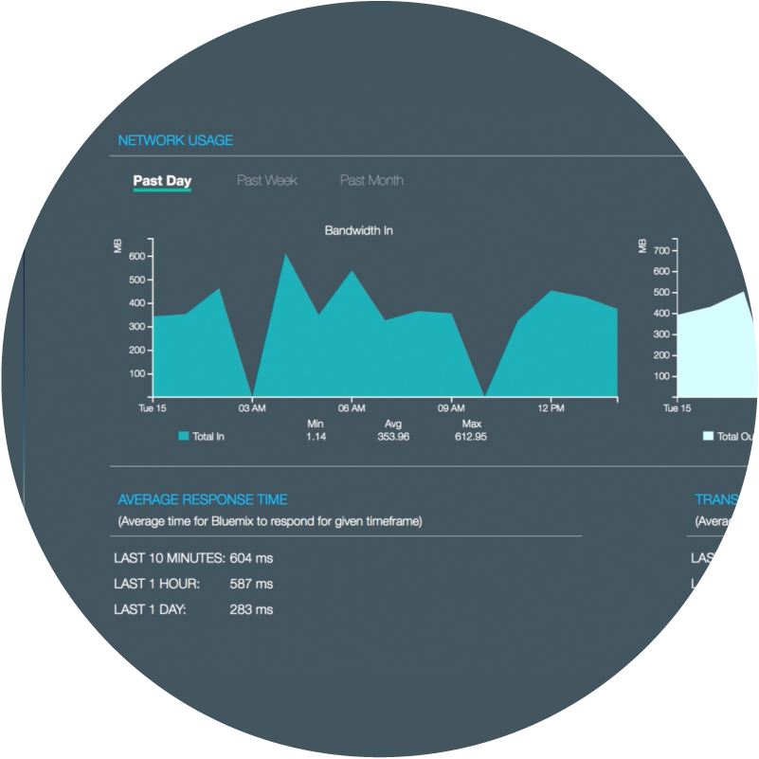
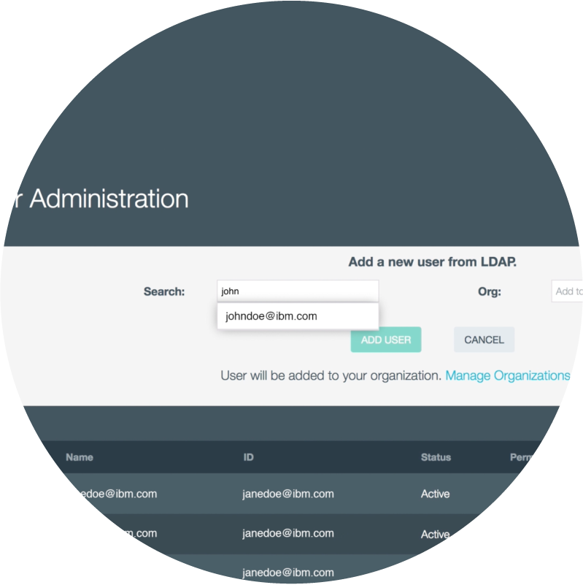
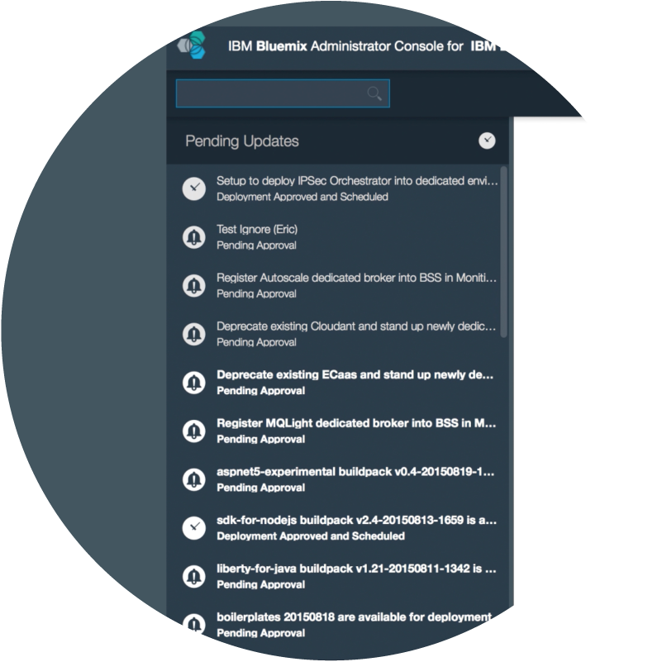
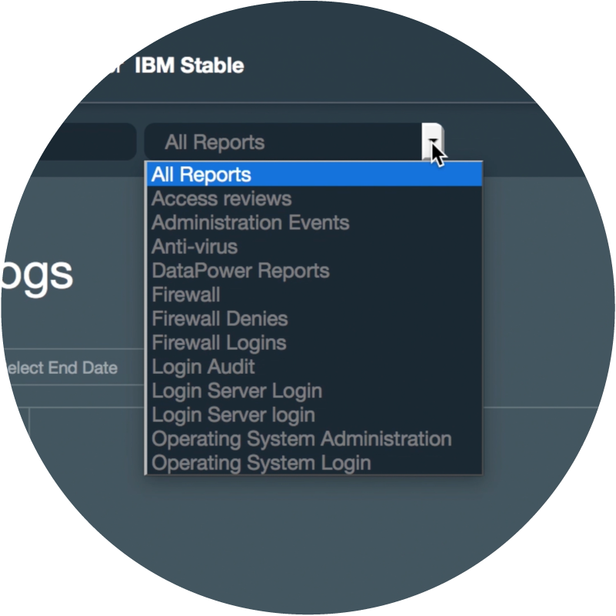
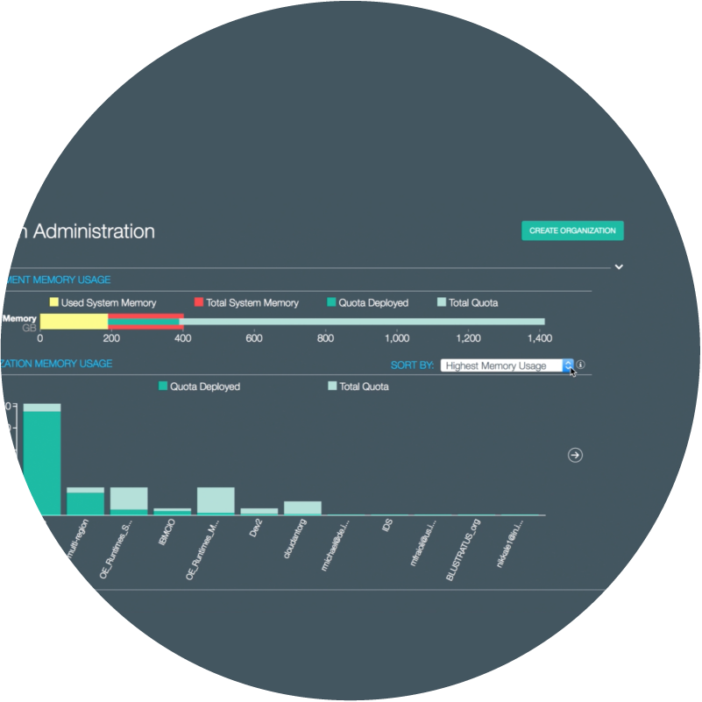

Seamless Experience via Admin Console
Regardless of whether your apps and services sit in Public, Dedicated, or Local, you can expect a seamless and portable hybrid experience.
Control
services & platform updates
Utilize Visibility
across the platform
Govern users, orgs
& privileges
Syndicated Catalog
Control access to services and runtimes
System Information
Control access to services and runtimes
User Administration
Control access to services and runtimes
Platform Updates
Control access to services and runtimes
Reports and Logs
Control access to services and runtimes
Org Administration
Control access to services and runtimes

Slide 25
Innovation makes disruption possible.
Bluemix services
for everyone,…..everywhere

Slide 26
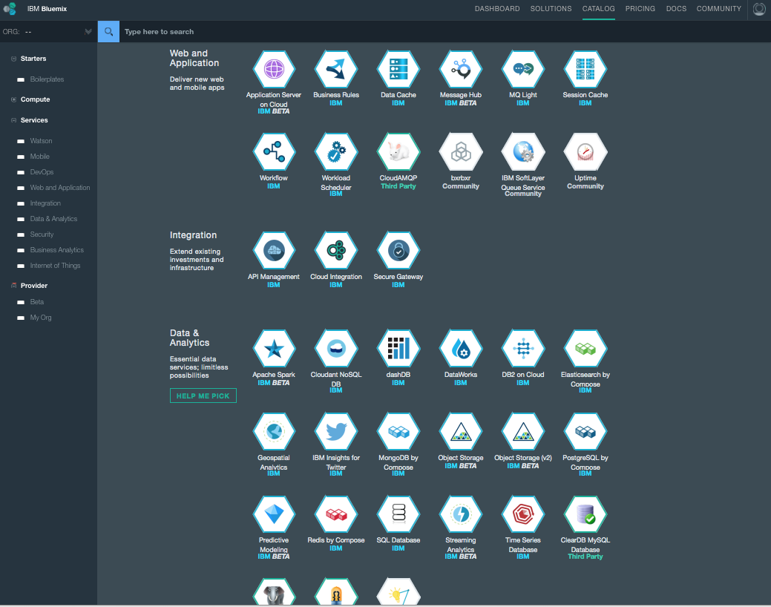

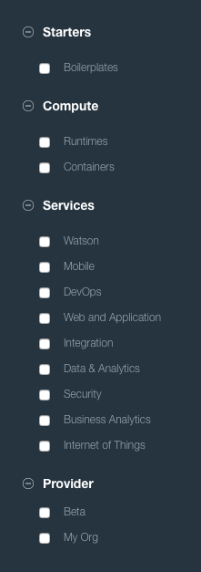




Broad range of IBM & 3rd Party Services
Commerce
Healthcare
Analytics
Watson
Security

Slide 27


Watson on Bluemix
Watson is creating a new partnership between people and computers that enhances, scales and accelerates human expertise
Reason
Listening
Speech
Learning
Vision
IBM Watson services available on Bluemix are the building blocks for developers to create the next generation of cognitive applications to transform the way businesses engage with their customers, discover, innovate and make decisions
…build with Watson
Notes:
Watson is ushering in a new era of computing; it is fundamentally different from the conventional, programmable computing systems that we’re used to.
Watson mirrors the same cognitive process that we use every day to understand the world around us.
With its ability to learn and navigate the language and protocols of specific professions and industries, and communicate in natural language, Watson is revolutionizing the way we make decisions, become experts and share expertise, at scale.

Slide 28


IBM Mobile Services
Core services that just about every App needs
StrongLoop Arc
Enterprise Node.js to build, deploy, scale manage and deploy your mobile APIs
Core App &
Platform Services
Push
Increase User Engagement with Mobile Push Notifications
Cloudant
The Ultimate Data Store for Mobile Apps
Mobile Client Access
Simplified Mobile App User Authentication
Capabilities to manage the lifecycle of your Apps
Mobile App Server
Manage, secure, and optimize enterprise mobile apps
App Lifecycle
Services
AppScan Mobile Analyzer
Identify Mobile App Security Exposures
Mobile Quality Assurance
Continuously Improve Mobile User Experience
Capabilities to enable apps to make users more productive based on context
Mobile Content Manager
Create, manage, and deliver more relevant in-app content
Presence Insights
Enables Apps with Intelligent Mobile Location Data
Contextual
Services
Notes:
Mobile

Slide 29
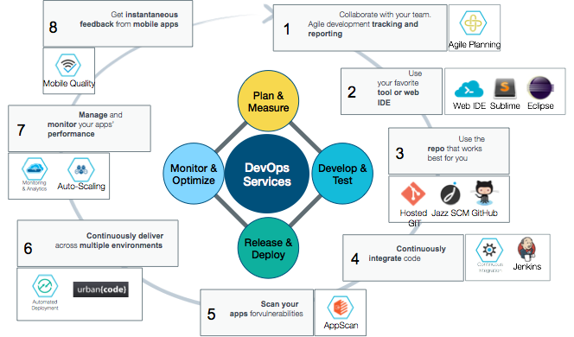
Continuous Innovation & Delivery
Fit for an enterprise, the DevOps experience is unified and open across compute technologies, Bluemix delivery methods, and integrated systems.

Slide 30

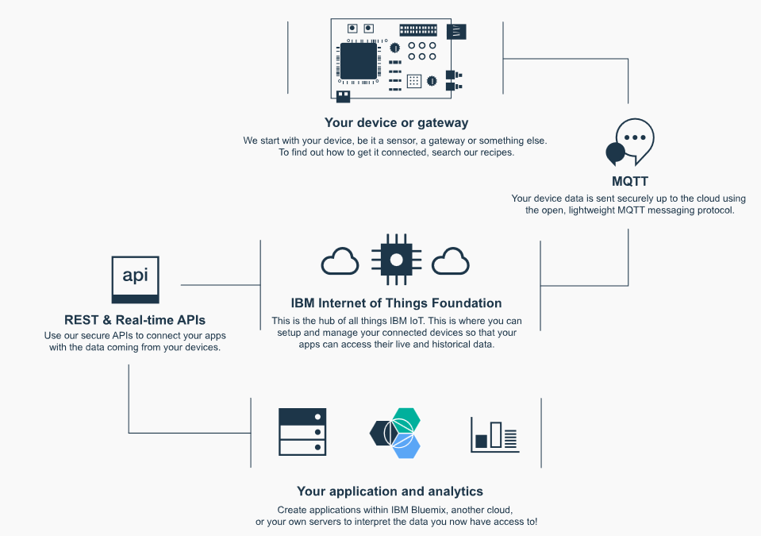

Turn new data into new value with IoT
Internet of Things Foundation
Set up and manage your connected devices so all your app’s can access the data
Notes:
IoT

Slide 31








New Patterns of Integration
Hybrid Integration
The Need
The Service
Secure
Gateway &
Connectors
IT
Connect
Securely connecting Bluemix to your local cloud
Data Analyst
Shaping your data for use by mobile and analytics
DataWorks
Refine
Delivering your data closer to your users
DataWorks
Data Analyst
Deliver
Rapidly compose and mix APIs into new apps
Connect &
Compose
Compose
App Developer
Exposing APIs and Data sets into the API Economy
API
Management
Expose

Slide 32
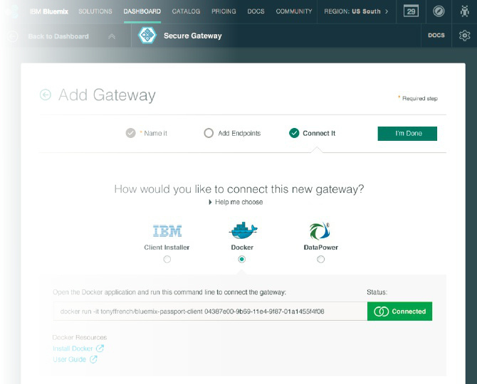

Connect Clouds Securely Together
Secure Gateway - creating a hybrid connection to on-premises data
Connect
IBM Secure Gateway: Provides secure connectivity from Bluemix to other applications and data sources running on-premise or in other clouds.
What’s unique?
Unique passport feature allows for single step download, install, and secure setup of client
Flexible Gateway topology allows segregation, Load Balancing, Fault tolerance
Layered security on the cloud side and client side
API / SDK for secure connect directly from app
Notes:
Intergration

Slide 33
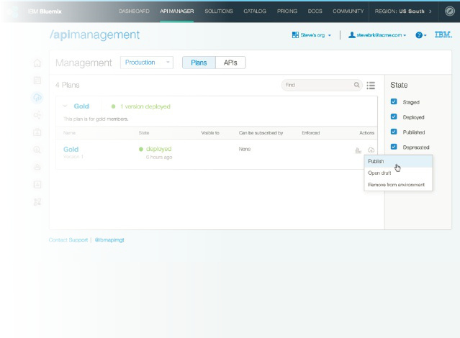
Expose APIs and Data
API Management to publish an API to Bluemix for developers to use as a service
Expose
IBM API Management: Enterprise API Management experience for all of your Bluemix APIs. Discover APIs from on-premises resources. Secure, layer policy, publish, and manage your APIs.
What’s unique?
Externalize an API from Bluemix to allow secure, governed, monitored usage of your app
Discover and load APIs to Bluemix from on premise sources like z/OS Connect and an ESB
Enable partners to innovate on your APIs by publishing into their Bluemix orgs via safe opt-in process
Notes:
Integration

Slide 34
Innovation makes disruption possible.
Bluemix openness
sets your innovation free

Slide 35










More openness and choice than ever before
Bluemix avoids vendor lock in. You choose how you build, deploy, and manage your apps. Bluemix make in infrastructure available.
Compute
Dev Tooling
Choose the level of infrastructure abstraction based on your app’s architectural needs.
From editors to source code management to continuous delivery, you can use Bluemix’ powerful tooling or easily bring your own.
Location
Services
Deploy apps to Bluemix Public (in a growing number of geos), your own dedicated cloud Bluemix, or one that runs within your data center (Local*).
Pick from a catalog of IBM, third party, open source, or your own services to extend your apps.
IBM
Third Party
Open Source
Yours
Notes:
Bluemix also allows flexibility when it comes to tooling - as, again, each developer has different preferences and needs.
Tooling Options:
IBM offers a web based integrated development environment (IDE) and associated git repository that allows quick deployments back to bluemix.
Developers can also edit code on their local machines (with the editor of their choice - i.e. Sublime) and deploy back to Bluemix through the cloud foundry command line.
Note to presenter: Other IDEs (like Eclipse, Cloud9) have direct integration with Cloud Foundry and can push code directly to bluemix, rather than a manual push by developer via command line. You may be asked about this.

Slide 36






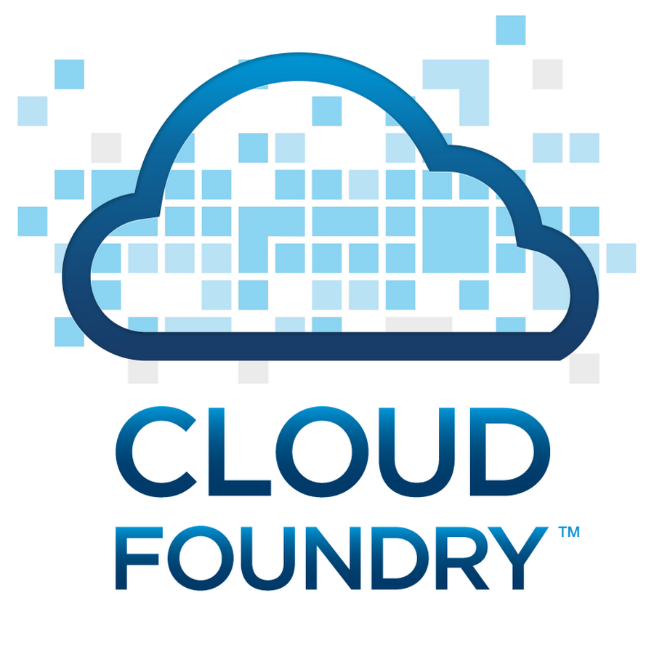



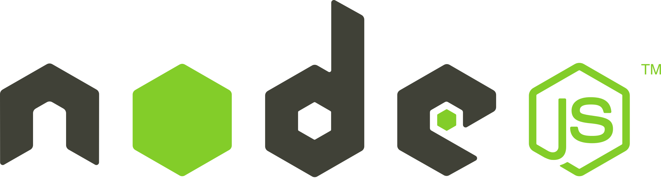


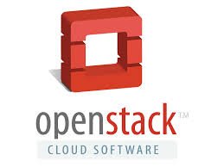





IBM Cloud is Open By Design
Open technology lynchpins maximize the effectiveness of Cloud investments
OAuth
SaaS
PaaS
IaaS
Private Cloud
Hybrid Cloud
Off-premise cloud

Slide 37
Innovation makes disruption possible.
Bluemix works
for everyone

Slide 38































What are customer doing with Bluemix
Startups
Enterprises
Instantaneous productivity
Start small, grow infinitely
Sophisticated, consumable services
Marketplace
Enterprise Fit
Differentiating Content
Cultural Transformation
Path to a new way to work
38
Notes:
Startups
Born on the cloud startups are leading many disruptions and using new ways to achieve breakthrough innovations
At the core of this disruption is a transformation and acceleration of innovation, development and delivery methods
These new methods, typically discussed as DevOps, encompasses a transformation of culture, processes and tools
Enterprise

Slide 39
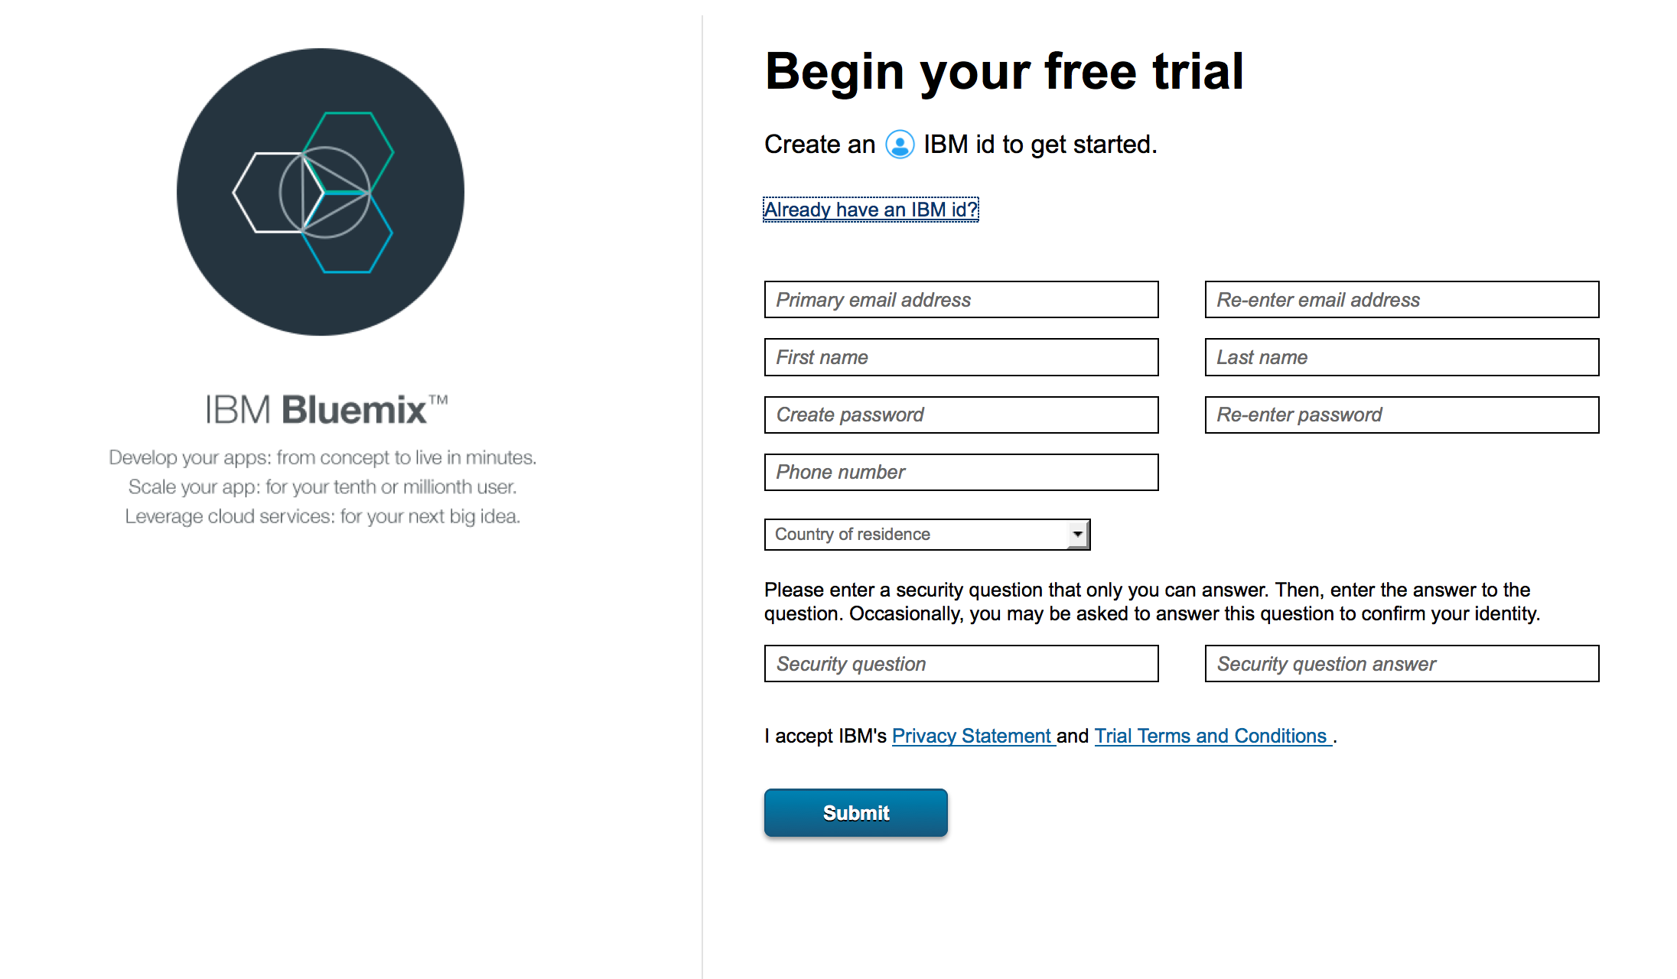
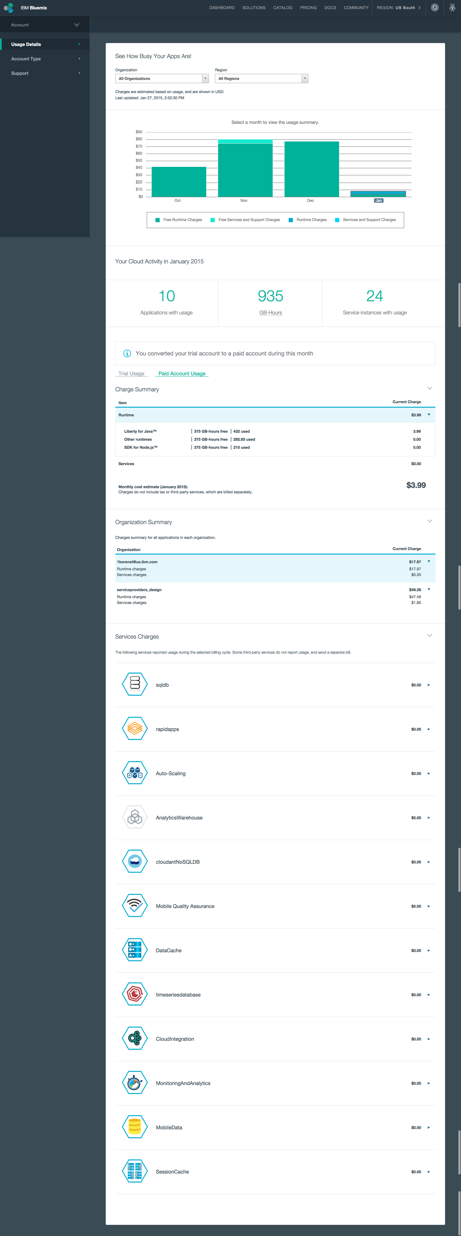
How do I get started? Sign up in minutes. Pay for what you use.
Friction free adoption
30 day trial (no credit card required) - Designed to allow testing of an entire application on the platform
Free tier for every service - encourages experimentation of new services for applications already running on Bluemix
Multiple Commitment Models
Pay-as-you-go - optimized for flexibility, no term commitment
Subscription - term based optimized for cost, discounted from pay as you go rates
Self Service
Zero to coding in less than 5 minutes
Credit card over the web in many countries - or through your IBM rep
Notes:
Bluemix’ pricing is just as flexible as many of the other capabilities we’ve discussed.
You can sign up for Bluemix in a matter of minutes
A 30 day free trial (no credit card required) allows you to experience all that Bluemix has to offer
A free tier for every service encourages further experimentation after the trial has ended
Once you’re ready to move forward with Bluemix, pricing is straightforward:
Pay as you go
Pay for what you use (runtimes/services) and nothing more
No commitment
Subscription
Pick a monthly commitment price and subscription term — receive a discount off of pay as you go rates

Slide 40
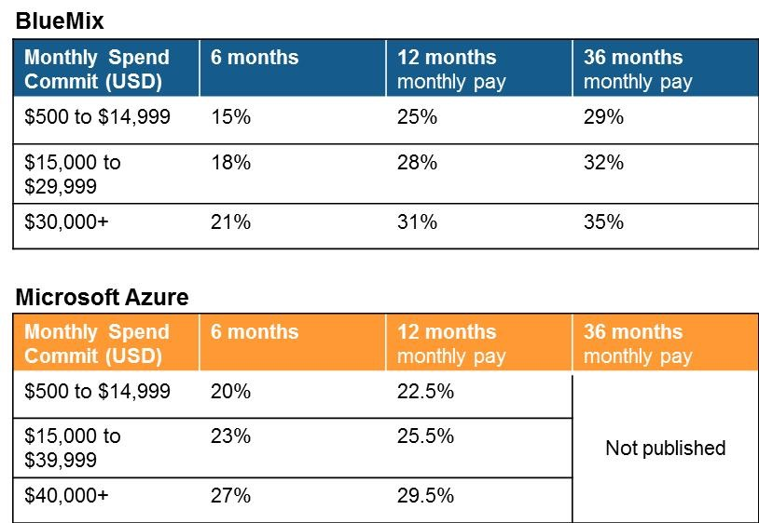
Public Pricing Structure
Pay as you go
Use case: Uncertainty around capacity or longevity of the application
User pays for usage of service metrics in excess of the free tier
Billed monthly and available via credit card only
List rates and no discounting is applied: value captured by no commitment and customer flexibility
Subscription
Use case: Heavy use, more predictable workload and multiple concurrent applications per account
User commits to spend level per period of time for discounts over pay as you go rates on the platform
Overages charged at pay as you go rates
Discounting (2x2 matrix)
Duration - 6, 12 and 36 month increments. Automatic and inside sales renewal
Spend on the platform
Co term will be allowed in order for a customer to increase their spend
Future Considerations
A subscription of Bluemix Public is always needed to run both Dedicated and Local Bluemix
Note: All prices are in USD and are subject to change without notice

Slide 41
Innovation makes disruption possible.
Bluemix helps
So your never alone

Slide 42




Bluemix in numbers
1B+
API calls per day
2,000+
New users per day
Largest
Cloud Foundry deployment
112,000+
Application starts per month
Notes:
Check with Bryan, can we use these numbers externally

Slide 43
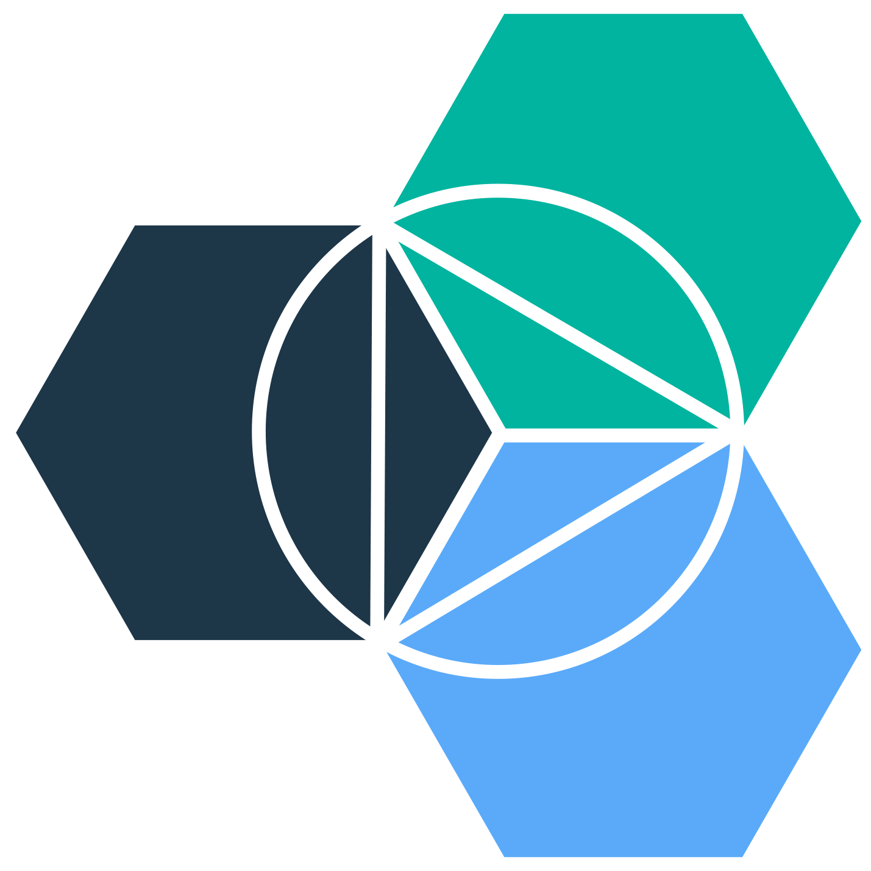





IBM Bluemix
THANK YOU
QUESTIONS?

